Slide 1
It’s all in the Permissions
Or can you just experiment to your hearts content?

Slide 2
What you need to ask for!
Before you start selecting your subjects and using them in your study regardless of what you are going to do with them you need to get permission from you subjects. This requires you to inform them of the nature of the study and what you hope to prove.

Slide 3
What you need to ask for!
What permissions do you need.
After selecting participants for the study, the researcher needs to obtain permission from the participants to be the subjects of the study. This permission will ensure that they cooperate in the study.

Slide 4

What you need to ask for!
What permissions will you need.
Also an important part of the permissions is the idea of informed consent. That the subject fully understands the purpose and intent of the study and what will happen to them and their data.

Slide 5
What you need to ask for!
Who to obtain permissions from:
1. Institutions or organizations.
2. Specific sites.
3. Participants.
4. If participants are minor then their parent/caregiver.
5. If participant is unable to give informed consent then their caregiver.
6. A research board or ethics committee.

Slide 6
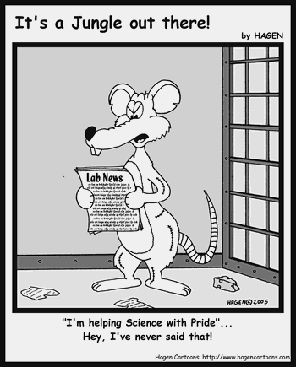
What you need to ask for!
What permissions will you need.
Failure to gain informed consent, could lead to the study being invalidated on ethical grounds. Subjects must be given the all the information, not half or different.

Slide 7

What you need to ask for!
Milgram videos
https://youtu.be/W147ybOdgpE
Stanley Milgram

Slide 8

What you need to ask for!
So to gain informed consent from your subject you cannot:
1. Allow them to come to any physical harm.
2. Allow them to come to any Psychological harm.
3. Lie to them about the nature or purpose of the study.

